Slide 1
Build Your Own Social Distancing Detection Tracker
Swayam Mittal
Senior Data Scientist
Indegene

Slide 2
Agenda
Social distancing
Object Detection
Social Distance Detection Algorithm
Hands-On Code

Slide 3
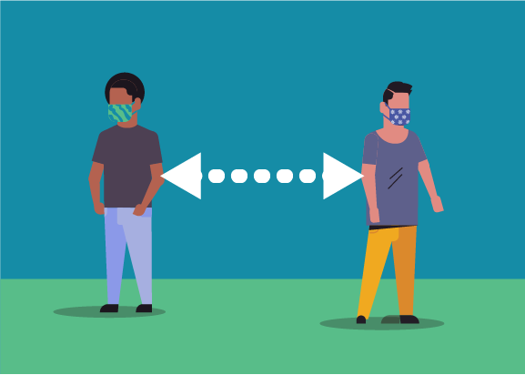
What is social distancing?
Social distancing is a method used to control the spread of contagious diseases as people maintains physically distance amongst themselves

Slide 4
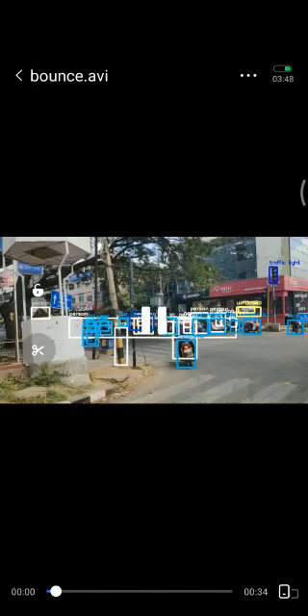
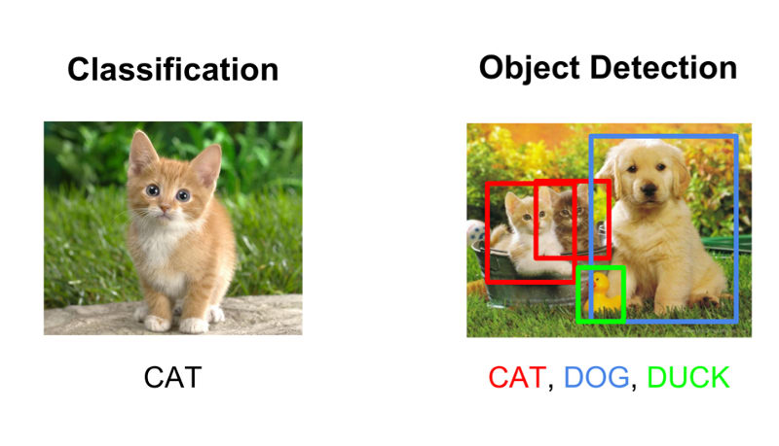
Object Detection vs Object Classification

Slide 5
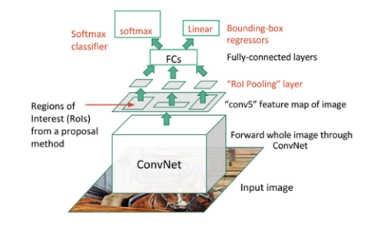
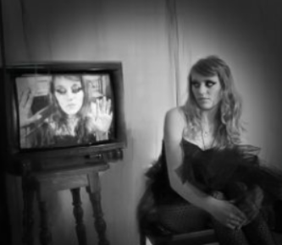
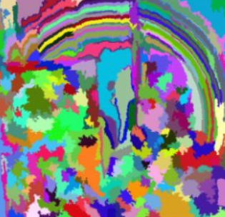
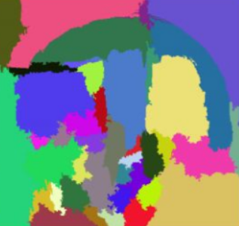
Steps for object detection
First we take an image as input
Then we use region-based CNN to generate multiple regions from this image as sub-segmentations
The technique then combines the similar regions to form a larger region based on colour, texture, size, and shape compatibility and similarity
Finally these regions produces the object locations (Region of Interest).
Pass all these regions to the CNN and classify them into various classes
Once we have classified each region into its corresponding class, combine all these regions to get the original image with the detected objects
input image
sub-segmentations
region of interest

Slide 6
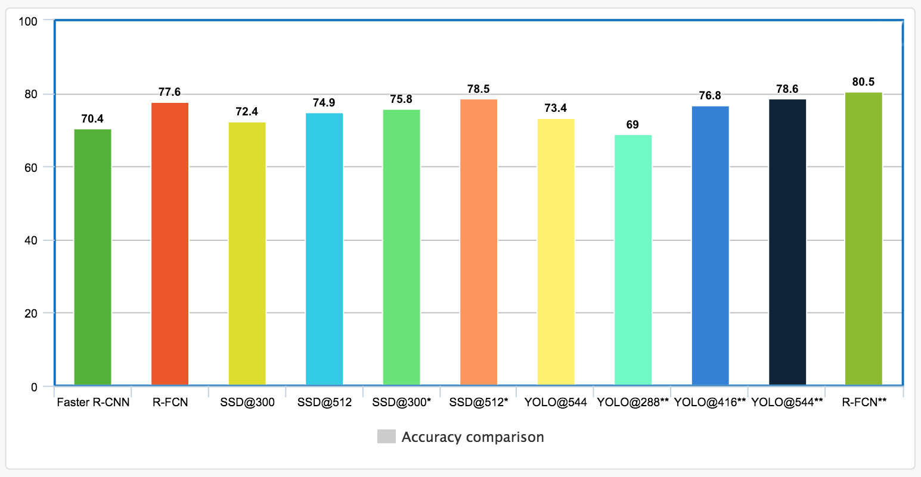

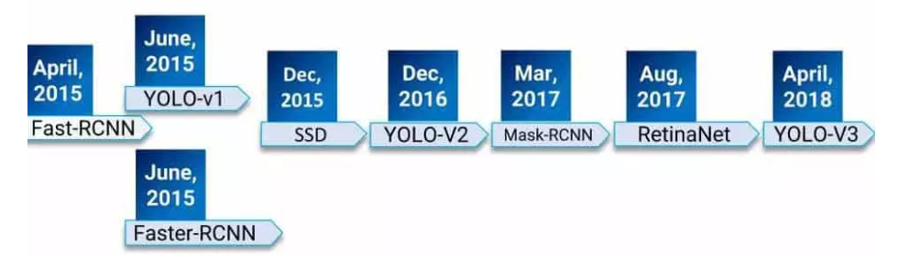
State-of-the-Art Models for Object Detection

Slide 7
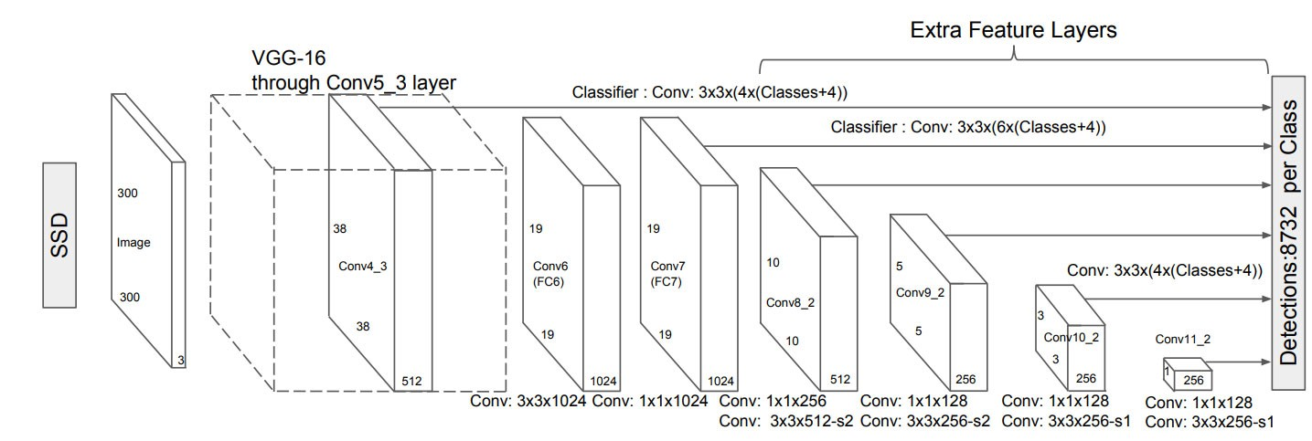

SSD - MobileNet Model
Single Shot means the tasks of object localization and classification are done in a single forward pass of the network
Multi-box means fast class-agnostic bounding box coordinate prediction
Detector means classification of those detected objects
MobileNet takes in the input image and outputs regions where objects may be present known as regions of interest
SSD takes in these regions of interest and classifies it into one of the target object classes

Slide 8
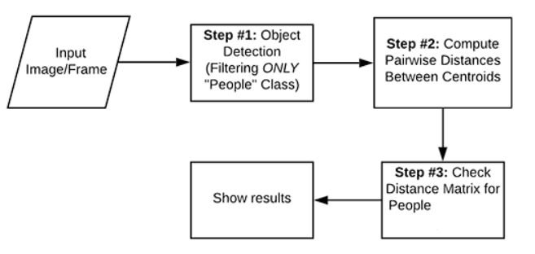
Social Distance Detection

Slide 9
Algorithm
To calibrate the camera, Let us assume that a person is at a distance D (assuming distance of person from the camera is 400cm) from camera and the person's actual height is H (assuming the average height of humans is 165cm). Using the object detection model we identify the pixel height P of the person using the bounding box coordinates. Using these values, the focal length of the camera can be calculated using:
After adjusting the focal length of the camera, as we continue to move camera both closer and farther away from the object, we can apply the triangle similarity to determine the distance of the object to the camera using the actual height H of the person, pixel height P of the person and focal length F of camera using formula :
We have the x, y (anchor box centroid) and z (distance of the person from camera) coordinates for every person. The Euclidean distance between every person detected is calculated between the mid-point of the bounding boxes of all the people detected using the (x, y, z) coordinates.
These pixel values are converted into cm using:
If the distance between two people is less than 2 meters or 200 centimeters, a red bounding box is displayed around them indicating that they are not maintaining social distance.
F = (P x D) / H
D' = (H x F) / P
(Pixel x Distance) / Focal length

Slide 10
Code
https://github.com/swayam01/Social-Distance-Algorithm

Slide 11
Practical Deployment
The camera needs calibration so we can map the pixel distance correctly to the real world distance
The code here is quite light weight and could run on an embedded device like Jetson TX2 connected to a camera.
If there is a social distancing violation an action can be triggered.

Slide 12
Thank You

